Slide 1
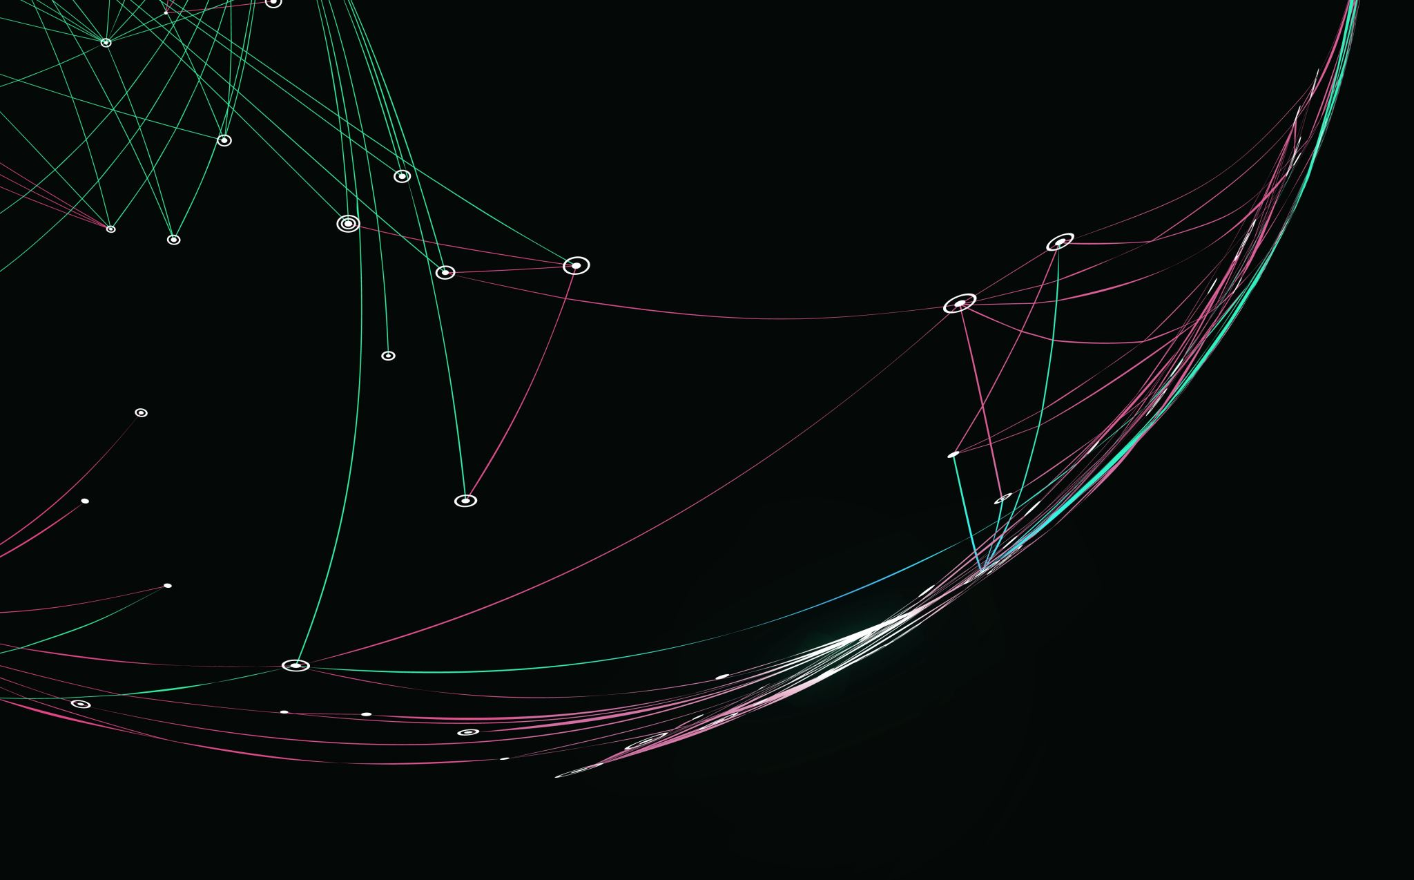
Business Case Analysis
Pason Systems Inc.

Slide 2


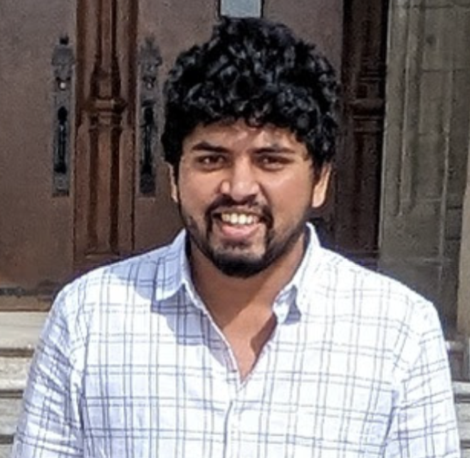


Meet Our Team Members
We are a group of dedicated Management students from SAIT, collaborating to deliver a comprehensive business analysis of Pason Systems Inc. Below are our team members who contributed to this project
01
02
03
04
Saran Poocharoen
Deanna Rose Quiambao
Prajwal Nagaraj
Thi Hanh Nguyen Phan
linkedin.com/in/saran-poocharoen/
linkedin.com/in/deannarosequiambao/
linkedin.com/in/prajwal-nagaraj/
linkedin.com/in/thi-hanh-nguyen-phan-915204292/
Group 2

Slide 3
Agenda
Overview of Pason Systems Inc.
Environmental Analysis: PESTLE and Porter’s Five Forces
SWOT Analysis
Identified Problems and Opportunities
Value Chain and Resources and Capabilities
Recommendations
Control Mechanisms for Implementation
Conclusion

Slide 4
Overview
Pason Systems Inc. specializes in data management systems for oil and gas drilling.
Solutions include data acquisition, wellsite reporting, automation, and analytics.
Global presence in key oil and gas regions.
Over 40 years of industry-leading innovation and service.
Source: Pason System Inc. Official Website and Annual Reports

Slide 5
PESTLE Analysis
Political | Global political issues | Government Regulation. | Political Stability in the Middle East and elsewhere
Economic | Inflation. | Volatile commodity prices. | Global supply chain challenges. | Supply and Demand for Crude Oil and Natural Gas Low-carbon economy. | Pipeline Availability. | Import and Export. | Foreign Exchange. | Availability of Alternate Fuel Sources
Social | Consumer demand for low-carbon fuels. | Employee Diversity. | Customer Financial Constraints | Pressure from the Investment Community
Technology | Intellectual technology. |. Data usage for automation and analytics. |. Data privacy and security.
Legal | Business Corporation Act (Alberta). | Pason Systems Inc. By-Law. | HSE policies and reviews. | Compliance with laws and regulations. | Taxes and penalties | Alternative energy incentives and mandates Emergency Response Procedure. | Investment and Dividends Policies
Environment | Greenhouse gas (GHG) emissions. | Pollution and environmental waste. | Prevailing Weather Conditions Accessibility of ground conditions. | Environment and Social Responsibility. | Climate Change initiatives Environmental accidents and disruptions. | Environmental regulations
Rising demand for low-carbon energy and alternative energy mandates threaten Pason's hydrocarbon market, while vulnerabilities in IT infrastructure expose it to cybersecurity risks, reputational damage, and higher operational costs.
Sources: Pason Annual Information, 2023; Pason Annual Report, 2023; Pason Information Circular, 2023; Pason Sustainability Report, 2023; PSI Amended and Restated Bylaws; Investor Presentation, Q3 2024; Management’s Discussion and Analysis Pason, Q3 2024; Annual Special Meeting of Shareholders, 2024;

Slide 6
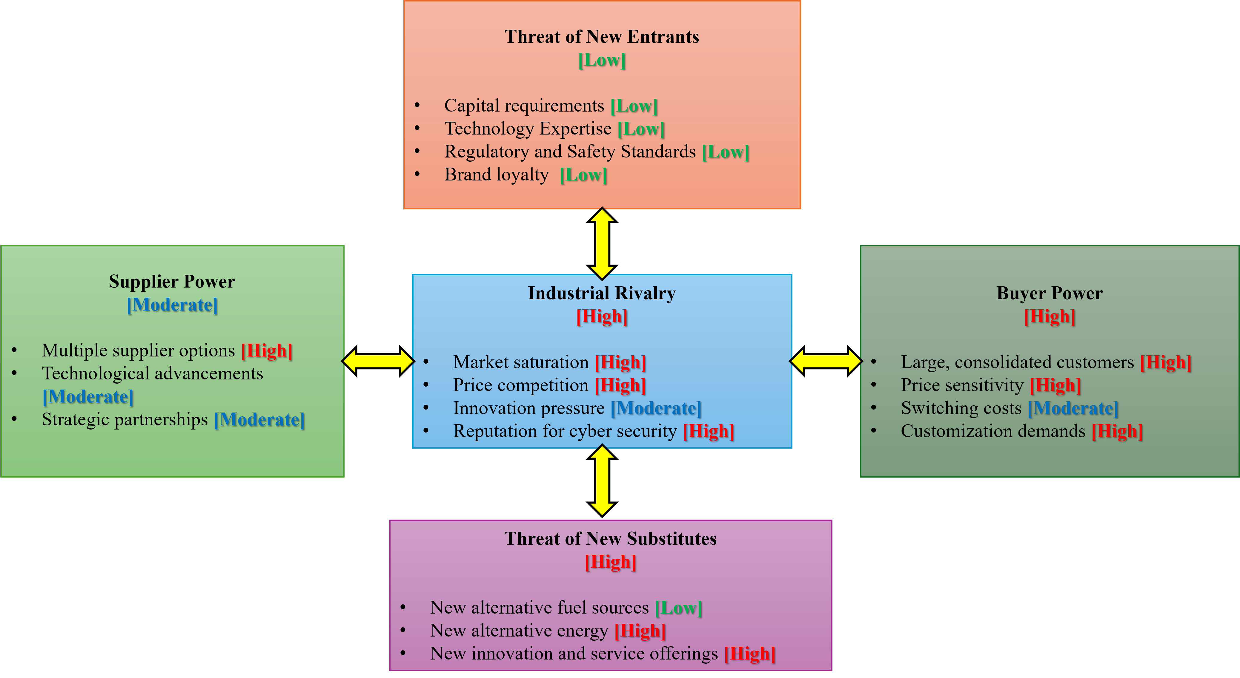
Porter’s Five Forces
High substitute threats and intense industry rivalry pose risks to Pason’s financial performance, cybersecurity reputation, and operational costs.
Sources: Pason Annual Information, 2023; Pason Annual Report, 2023; Pason Information Circular, 2023;
Management’s Discussion and Analysis Pason, Q3 2024; Investor Presentation, Q3 2024; Annual Special Meeting of Shareholders, 2024;

Slide 7
SWOT Analysis
Strengths | Weaknesses
Global presence More than 40 years of operation Outstanding financial profile Acquisition of IWS and Energy Tool base Drilling & completion activity Distinctive technology and service offerings New technology development Leading economic modeling software tool Growing control system sales pipeline Strong Safety Culture Environmental Responsibility Advanced cyber security rating (BitSight score of 790) | Difficulties in integrating administration due to the acquisition of IWS and Energy Toolbase Total Recordable Injury Rate (“TRIR”) of 95% Highly dependent on attracting and retaining qualified workforce
OPPORTUNITIES | THREATS
Government policies incentivize additional energy storage Demand for renewable energy Global demand for oil and gas Customers’ demand for deploying data-driven automation and analytics technologies in their operations | Volatility in commodity prices Global geopolitical instability and recession risk Potential security breaches, viruses or malware, cyber security attacks Computer or telecommunication errors Credit and liquidity risk Availability of Raw materials Regulatory and Policy Risks Alternative Energies Risk Natural disasters, energy blackouts, operating malfunctions, Human error, internal or external misconduct Supplier relationships Global supply chain disruptions Patent infringement lawsuit
Pason's acquisitions of IWS and ETB offer opportunities to address alternative energy risks but pose integration challenges, while rising demand for data-driven automation necessitates maintaining advanced cybersecurity standards.
Sources: Pason Annual Information, 2023; Pason Annual Report, 2023; Pason Information Circular, 2023; Pason Sustainability Report, 2023; PSI Amended and Restated Bylaws; Investor Presentation, Q3 2024; Management’s Discussion and Analysis Pason, Q3 2024; Annual Special Meeting of Shareholders, 2024;

Slide 8
Identified Problems/Opportunities
Problem 1: Alternative Energy Risk The shift toward low-carbon energy threatens the demand for hydrocarbons.
Problem 2: Cybersecurity Risk Threats of data breaches and operational disruptions.

Slide 9
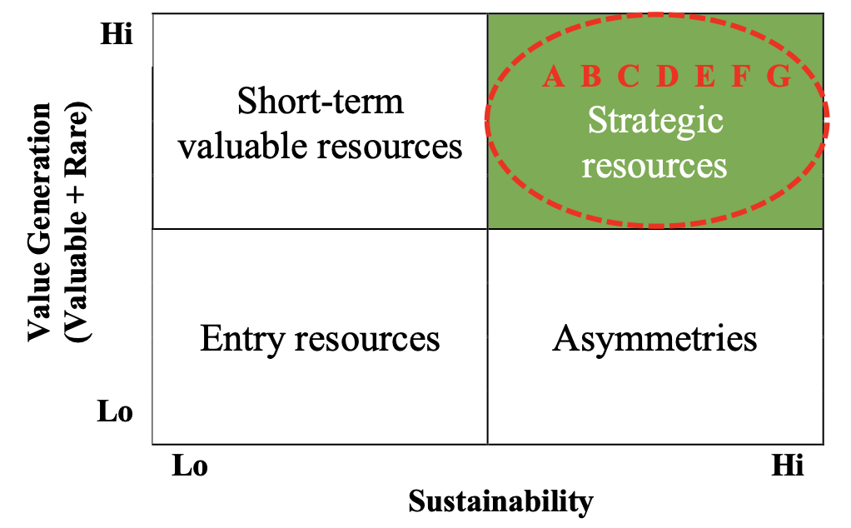
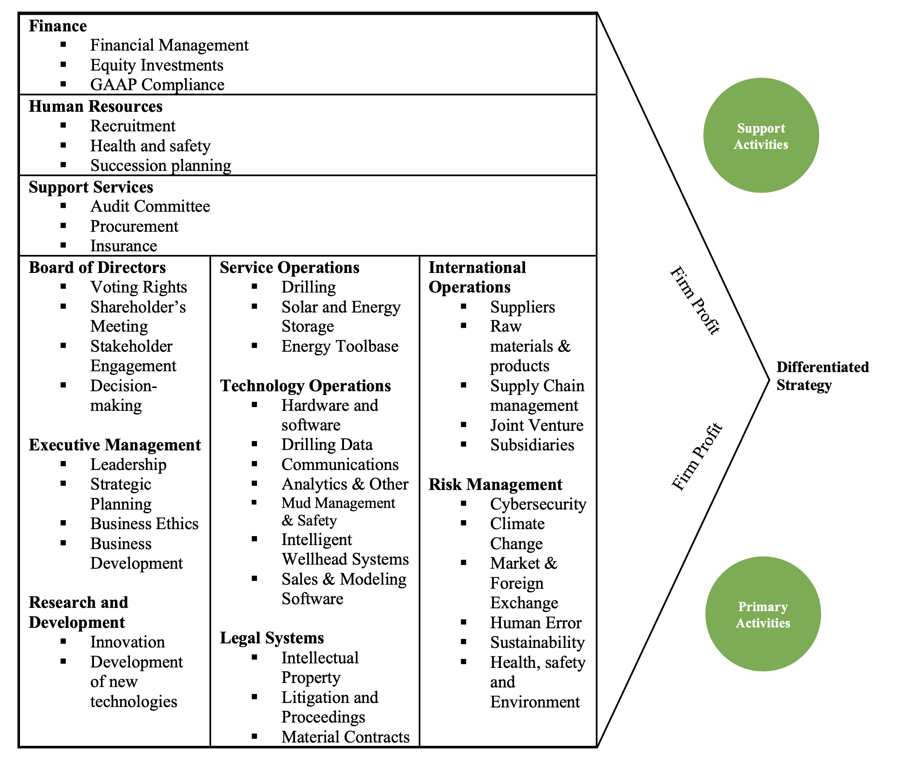
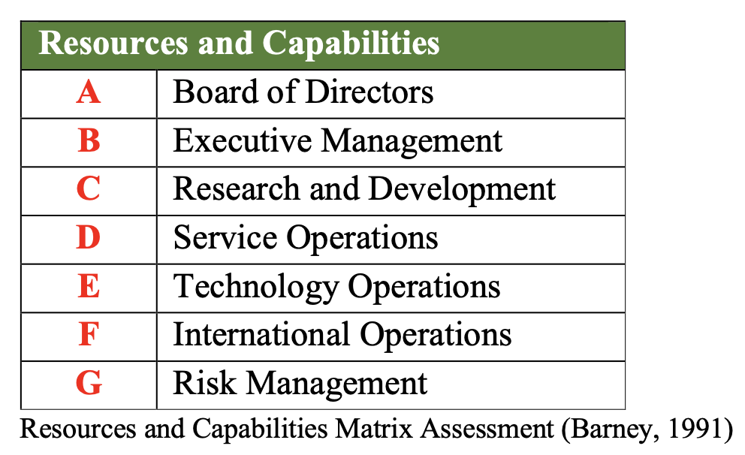
The Value Chain of Pason Systems Inc.

Slide 10
Resources and Capabilities
Resources | Capabilities
Brand name | Trusted and established a reputation for over 40 years
Capital | High-end instrumentation and data services to operators, contractors, and other oilfield service companies
Global Presence (North America, South America, Central America, Middle East) | High-value energy services and end-to-end technology
Existing Suppliers, Crude Oil and Product Inventories Drilled and Uncompleted Wells (DUCs) | Efficient supply chain management and maintaining operational continuity
Acquisition & Investments | Expansion of Technology & Service Offerings Development of economic modeling software tool
Research and Development | Development of new technologies
IT Infrastructure | Capture, Transmit, Process, and Store significant quantities of electronic information
Cyber Security | Protection for sensitive operational data and secure communications across systems
Common Shares | Voting rights for shareholders, fostering governance and accountability
Board of Directors | Decision-making and business ethics
Investors and Joint Partnerships | Securing funding and investments in the oil and gas industry
Highly-skilled diverse workforce | Creative and innovative pool workforce
Certified Safety Professionals | Compliance with safety and regulatory requirements
Insurance | Protection for personal injury, loss of life, business interruption, property damage, pollution, and other liabilities
Sources: Pason Annual Information, 2023; Pason Annual Report, 2023; Pason Information Circular, 2023; Management’s Discussion and Analysis Pason, Q3_2024; Investor Presentation, Q3 2024; Annual Special Meeting of Shareholders, 2024;

Slide 11
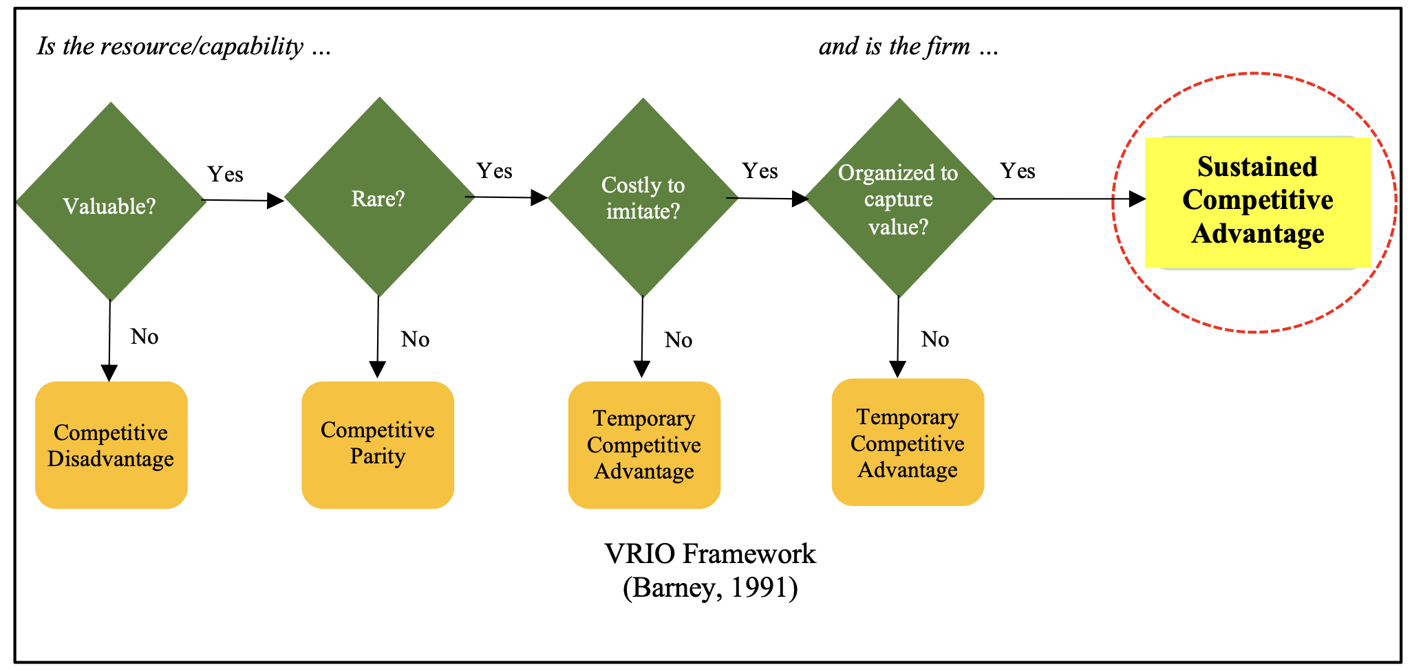
Evaluating Pason Systems Inc.’s VRIO
Resource/ Capability | Is it valuable? | Is it rare? | Is it difficult to imitate? | Is it organized to capture its value? | Can it be a basis for competitive advantage?
Brand name | Yes | Yes | Yes | Yes | Yes
Capital | Yes | Yes | Yes | Yes | Yes
Global Presence (North America, South America, Central America, Middle East) | Yes | Yes | Yes | Yes | Yes
Acquisition & Investments | Yes | Yes | Yes | Yes | Yes
Investors and Joint Partnerships | Yes | Yes | Yes | Yes | Yes
High-value energy services and technology | Yes | Yes | Yes | Yes | Yes
Research and Development | Yes | Yes | Yes | Yes | Yes
Existing Suppliers, Crude Oil and Product Inventories Drilled and Uncompleted Wells (DUCs) | Yes | No | Yes | Yes | No
IT Infrastructure | Yes | No | No | Yes | No
Pason Systems Inc.'s competitive advantage stems from its strong brand, global presence, strategic acquisitions, investments, joint partnerships, and innovations. However, to stay ahead of rivals, it must focus on mitigating risks and enhancing its IT and supply chain management.

Slide 12
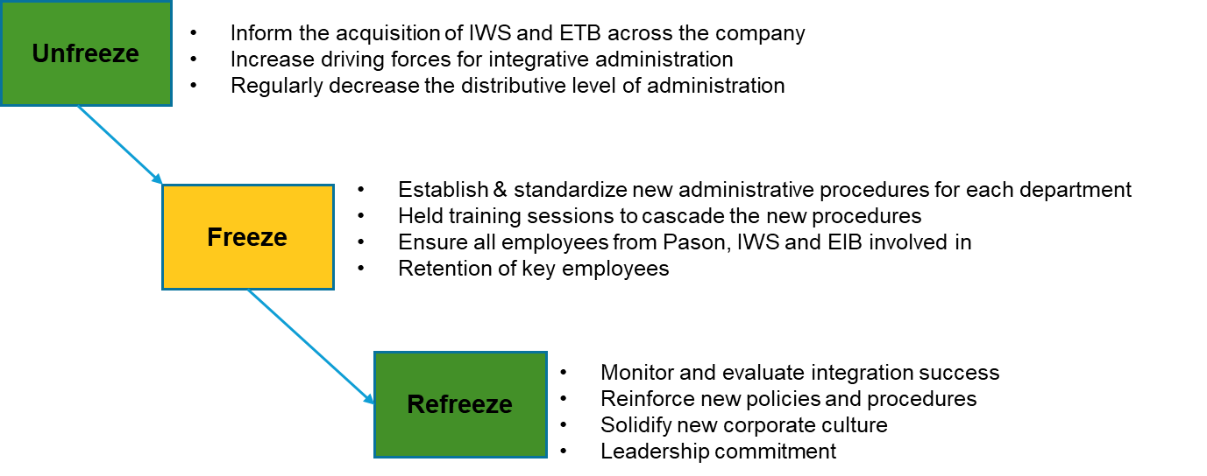
Recommendation 1: Establish integration procedures for new Acquisitions (IWS and ETB)
Implement Lewin’s Change Model for structured integration. Focus on aligning administrative, operational, and financial systems. Provide consistent training across all levels.
Lewin’s Change Model Process
Source: (Rice University, 2019)

Slide 13
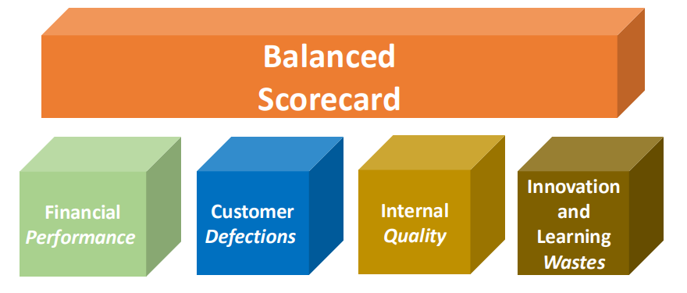
Control for Recommendation 1: Balanced Scorecard Approach
Scorecard | Objectives | Measures
Finance | Improve financial performance post-acquisition | Return on Investment (ROI) will increase by 10% in the first year after the acquisition
 | Optimize costs for administration | The cost-to-revenue ratio will reduce by 5% in the first year after the acquisition
 | Increase revenue from new acquisitions | Revenue will increase 5-7% in the first year after acquisition
 | Improve cash flow | Positive cash flow from operations
Customer | Retain key customers from IWS and ETB | Retain 90% of customers from IWS and ETB
 | Ensure customer satisfaction by integrating administrative | Not more than 3% of customer complains
Internal process | Achieve successful integration of administrative systems | 100% systems integration within 6 months
 | Maintain operational continuity | 99% uptime during integration
Learning & Growth | Number of training hours per employee | Minimum of 40 hours per employee per year
 | % of employees trained on new systems | 100% trained within 6 months
(Source: SAIT Module 10, 2024)

Slide 14
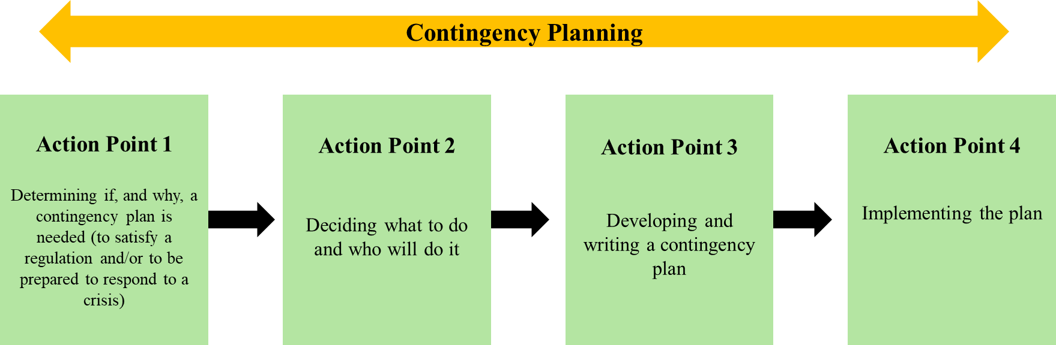
Recommendation 2: Enhance Cybersecurity Measures
Develop a contingency plan for potential breaches. Implement advanced threat detection systems. Conduct regular IT infrastructure audits.
Contingency Planning Four-Step Process
Source: (Hollingsworth, 1991)

Slide 15
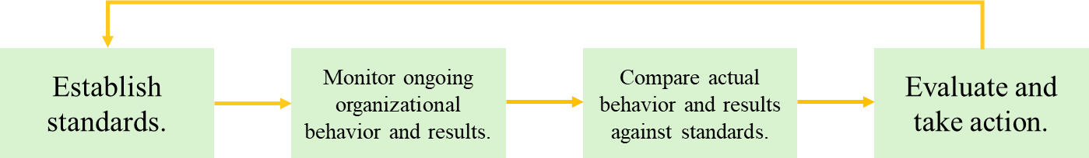
Control for Recommendation 2: Cybersecurity Control Model
Performance metrics: Threat detection rate, recovery time, anomaly response. Regular audits and system evaluations. Continuous monitoring to mitigate risks.
The Traditional Control Model
Source: (Rice University, 2019)

Slide 16
Proposed Control Model
Strategic Objectives
Key Performance Indicators | Objectives | End Result | Weight
Access Control | Perimeter defense in depth using web and traditional firewalls with intrusion prevention | Reduce unauthorized access attempts by 99%, with fewer than five incidents annually | 15%
Authentication Coverage | Multi-factor authentication for all critical applications | Achieve 100% MFA implementation with zero unauthorized access incidents | 10%
Threat Detection | Third-party monitored endpoint detection and response | Detect and resolve 95% of security threats within 24 hours | 10%
Anomaly Response | Continuous cloud anomaly detection and code scanning | Detect and address 99% of security anomalies in real-time | 10%
Vulnerability Fixes | Annual penetration testing of web applications | Identify and resolve 100% of critical vulnerabilities within 30 days | 15%
Recovery Efficiency | Disaster recovery time objective & and recovery point objective of no more than 24 hours | Resolve 100% of disruptions within 24 hours, meeting recovery time and point objectives | 20%
Incident Response | Advanced security operations center monitoring | Detect and respond to 100% of incidents within 15 minutes, resolve 98% within 24 hours | 20%
Total |  |  | 100%
Sources: Pason Sustainability Report, 2023 ; Fernandez & da Gama, 2008

Slide 17

CONCLUSION
Establish integration procedures for the newly acquired companies (IWS and ETB)
Enhance cybersecurity and preparedness for potential risks to maintain market leadership.
Recommendations will strengthen Pason’s resilience, sustainable growth and competitive edge.

Slide 18
References
Barney, J. (1991, March). Firm Resources and Sustained Competitive Advantage. https://journals.sagepub.com/doi/10.1177/014920639101700108
Fernandez, L.J., da Gama, F. S. (2008). Contingency Planning: A literature review. ResearchGate. https://www.researchgate.net/publication/230807504_Contingency_planning_-_a_literature_review
Hamby, T.W., Smith, J.R. (1972). Contingency Planning for Drilling and Producing High-Pressure Sour-Gas Wells. Journal of Petroleum Technology 24 (03): 347–356. Paper Number: SPE-3512-PA https://doi.org/10.2118/3512-PA
Hollingsworth, W. (1991). Contingency Planning: Implementation Is The Key. International Oil Spill Conference Proceedings (1991) 1991 (1): 19–23. https://doi.org/10.7901/2169-3358-1991-1-19
Pason Systems Inc. (2023). Management’s Discussion and Analysis. https://www.pason.com/investors/investor-information#analysts.
Pason Systems Inc. (2023). Annual Report. https://www.pason.com/investors/investor-information#analysts
Pason Systems Inc. (2023). Information Circular. https://www.pason.com/investors/investor-information#analysts
Pason Systems Inc. (2024). Annual Special Meeting of Shareholders. https://www.pason.com/investors/investor-information#analysts
Pason Systems Inc. (2023). Management’s Discussion and Analysis Pason. https://www.pason.com/investors/investor-information#analysts
Pason Systems Inc. (Q3, 2024). Management’s Discussion and Analysis Pason. https://www.pason.com/investors/investor-information#analysts
Pason Systems Inc. (Q3, 2024). Investor Presentation. https://www.pason.com/investors/investor-information#analysts
Pason Systems Inc. (2023). Annual Information Form. https://www.pason.com/investors/investor-information#analysts
Pason Systems Inc. (2023). Sustainability Report. https://www.pason.com/investors/investor-information#analysts
Pason Systems Inc. (2014). Amended and Restated By-Law Number 1. https://www.pason.com/investors/investor-information#analysts
Rice University. (2019). Principles of management. OpenStax. https://openstax.org/books/principles-management/pages/1-introduction
SAIT. (2024). Module 4: Planning & Decision-Making / Managerial Mindset. In MNGT-255: Introduction to Management [MLB]. D2L/Brightspace. https://learn.sait.ca
SAIT. (2024). Module 6: Innovation and Change. In MNGT-255: Introduction to Management [MLB]. D2L/Brightspace. https://learn.sait.ca
SAIT. (2024). Module 10: Control. In MNGT-255: Introduction to Management [MLB]. D2L/Brightspace. https://learn.sait.ca

Slide 19

THANK YOU

